Slide 1
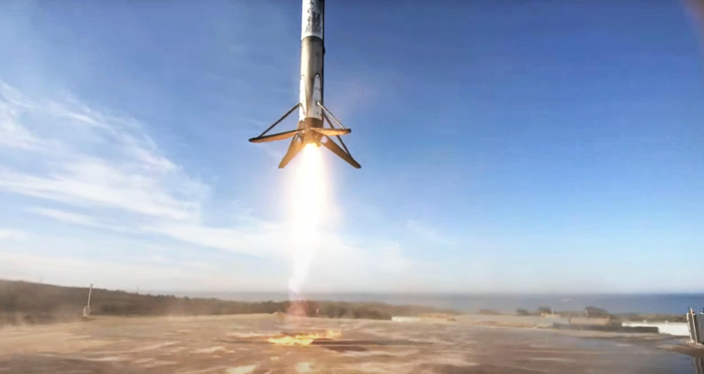

Space x Falcon 9 stage 1
Jared
today

Slide 2

Executive Summary
Introduction
Methodology
Results
Conclusion
Appendix
Outline

Slide 3
Executive Summary
1. Project Overview:
Using historical launch data, my goal is to predict the outcome of Falcon 9 launches. Predicting the success of the first stage can potentially save up to $60 million USD
2. Methodology:
Data acquisition through API and web scraping, followed by preparation in Python. Exploratory Analysis involved SQL, visualizations, and interactives applications. I employed Logistic Regression, Support Vector Machines, Decision Trees, and K Nearest Neighbors as classification models, evaluating their performance with confusion matrix charts and other metrics.
3. Results:
My classification models accurately predict the outcome with a <ACCURACY> percent accuracy. Notably, the best models correctly identified each failure, with a couple false positives

Slide 4
Introduction
SpaceX was founded in 2002 by Elon Musk
The Falcon 9 is a medium lift launch vehicle, capable of delivering 50,265 lbs to orbit
began development in 2005. First launch in 2010
First successful landing in 2015
We would like to see if there are any patterns in the features involved in the falcon 9 and the likelihood of a successful landing

Slide 5

Methodology

Slide 6
Methodology
Data Collection
API Access
Web scraping
Perform data wrangling
Describe how data was processed
Perform exploratory data analysis (EDA) using visualization and SQL
Perform interactive visual analytics using Folium and Plotly Dash
Perform predictive analysis using classification models
How to build, tune, evaluate classification models

Slide 7

Data Collection
Two strategies were used for data collection
Request from SpaceX API
Web scraping tables from webites

Slide 8
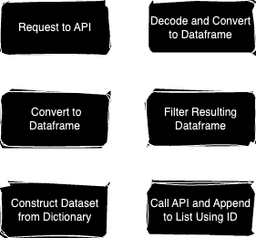
Data Collection – SpaceX API
Initial request to Spacex API. Store into a response variable
Use json() and pd.json_normalize to decode and convert to Pandas data frame
Select relevant features and drop unnecessary entries
Use ID numbers from data to iterate through url’s and append responses to lists
Construct dataset by combining columns into a dictionary
Filter dataset one last time to relevant entries

Slide 9
Data Collection - Scraping
Use Requests library to get HTTP response, and parse HTML content
Use HTML tags to append empty list with column header names
Create dictionary, define header names as keys, store values in associated columns
Iterate through HTML tables, rows, and cells. Append extracted values to respective columns
Create data frame from dictionary and save as .csv

Slide 10

Data Wrangling
Examine structure of dataset by checking first few rows, data types, and summary statistics
Clean up the data by dealing with missing values, correct data types, and handling outliers
Transform the data with feature engineering and encoding categorical variables

Slide 11
EDA with Data Visualization
Flight Number vs Launch Site
Over time, what launch sites were used
Payload vs Launch Site
Relationship between payload mass and launch site used
Success Rate vs Orbit Type
How orbit type can impact success rate
Flight Number vs Orbit Type
Over time, what orbits are we launching too
Payload vs Orbit Type
Is there a relationship between payload mass and orbit
Launch Success Yearly Trend
How has the rate of success changed over time

Slide 12

EDA with SQL
SQL to provide insights such as:
Launch site names
Total payload mass
Ave payload mass for specified boosters
Date of first successful ground landing
Information about launches with successful drone landings within specified payload mass range
Count of successful vs failure mission outcome
Which launches carried maximum load
Launch records for a specified year
Rank the count and type of outcomes within a date range

Slide 13

Build an Interactive Map with Folium
Create global markers of each launch site to see proximity to equator, coasts and other important features
Cluster launches into sites to create better interactivity
Color code site specific mission outcomes to visually identify trends

Slide 14
Build a Dashboard with Plotly Dash
Dropdown box to select sites
Pie chart to represent success rate of selected sites
Slider to select payload mass range
Scatter plot with slider as input on x-axis

Slide 15
Predictive Analysis (Classification)
First step was to import the data and create target variables for the models
To keep our inputs consistent with each other, I normalized the data
I separated the data into training and testing data
Then I created an object for each of the models
After the object was created, I defined the parameters and performed cross validation to find the optimal parameters for the model
Finally, I found various performance metrics and built confusion matrix’s to properly compare the models

Slide 16
Results
Most flights carried payload between 500 and 7000 kg
Dramatic increase in success rate from year 2010 to 2020
The logistic, Decision Tree, and K Nearest Neighbor Classification Models performed the best

Slide 17
Insights drawn from EDA

Slide 18
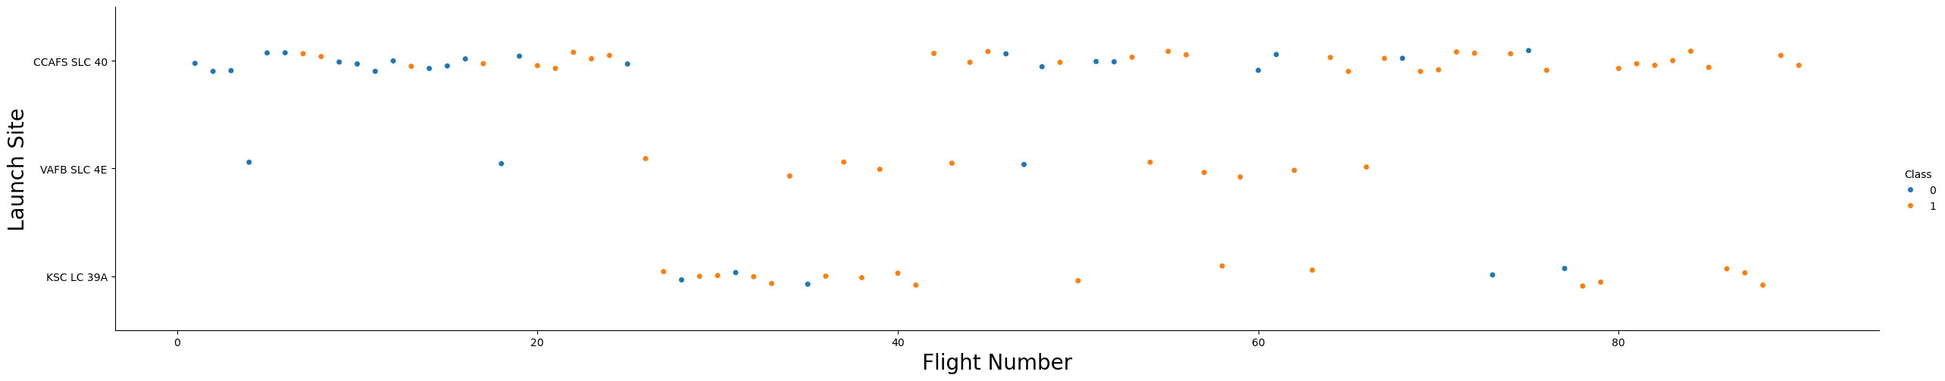
Flight Number vs. Launch Site
As flight number goes up, we have a higher rate of success
Vandenberg has the smallest number of launches
Most launches took place at Cape Canaveral and Kennedy

Slide 19
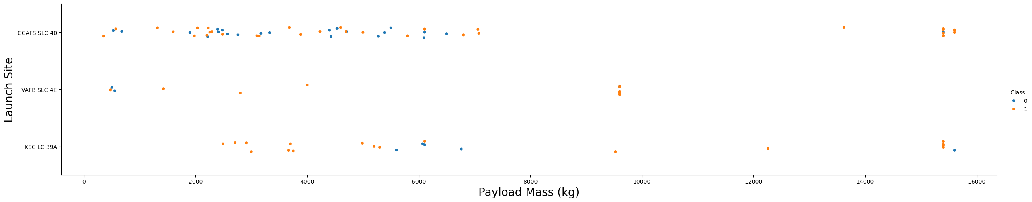
Payload vs. Launch Site
We see a very high success rate when payload is high
Majority of launches are in the 500 – 6000 range of payload

Slide 20
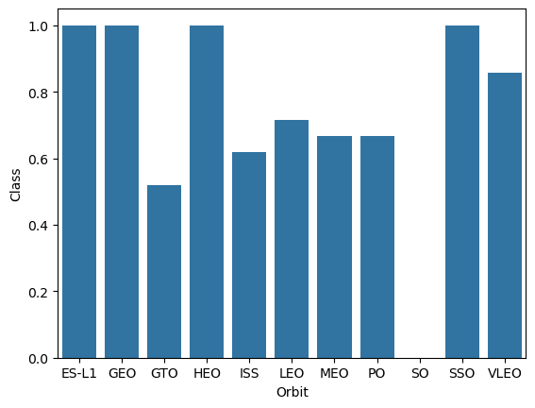
Success Rate vs. Orbit Type
Lowest success rate at Geostationary transfer orbit (GTO)
Lagrange point (ES-L1), Geosynchronous orbit (GEO), Highly elliptical orbit (HEO), and Sun-synchronous orbit (SSO) have a perfect success rate

Slide 21
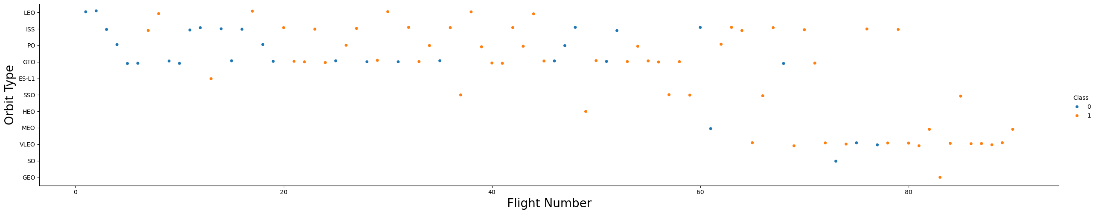
Flight Number vs. Orbit Type
Earliest flights did not include orbits ES-L1, SSO, HEO, MEO, VLEO, SO, GEO
We can also see that some orbits have good success rates due to low volume
Many Very low earth orbits (VLEO) have taken place recently with increasing success rate

Slide 22
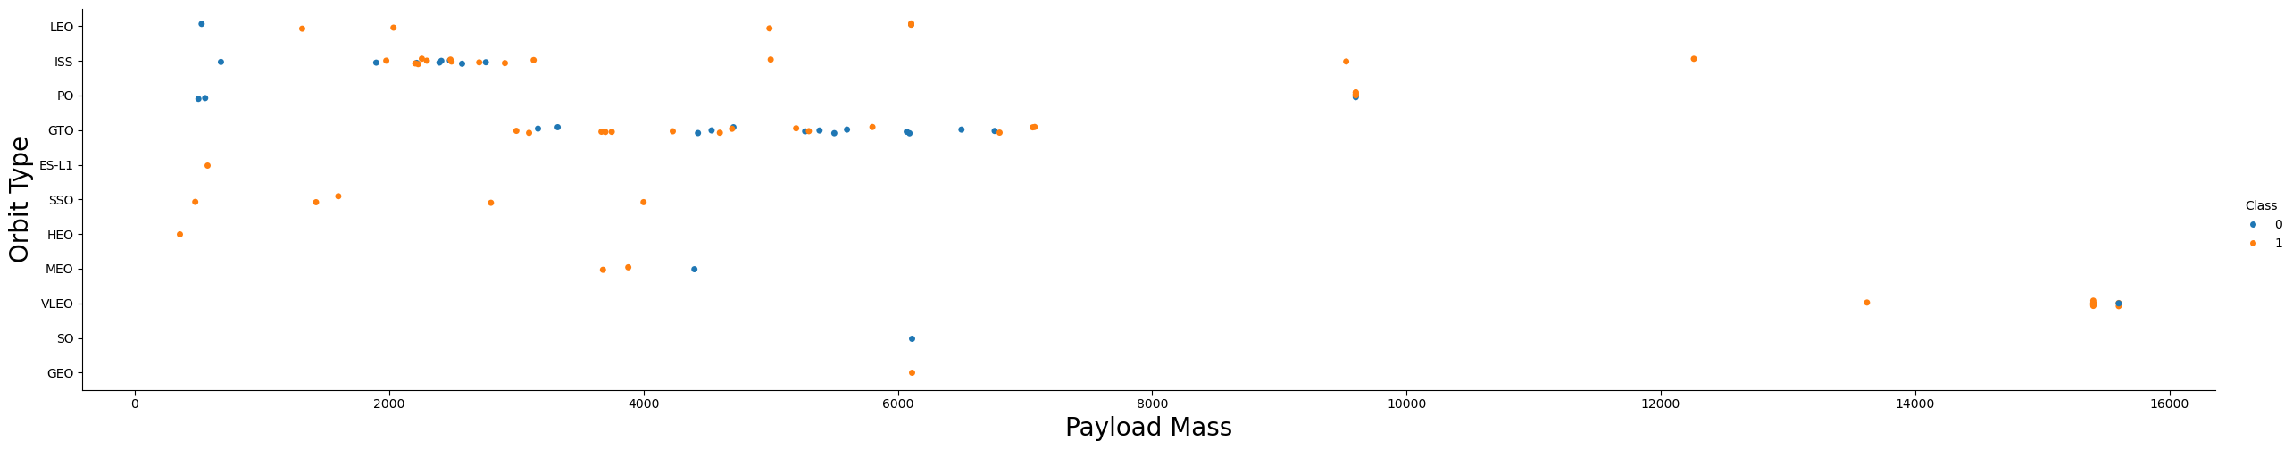
Payload vs. Orbit Type
We can see launches with the same orbit tend to fall into similar payload ranges
There are many outliers however

Slide 23
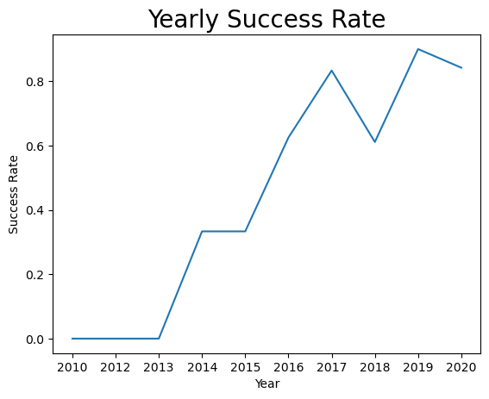
Launch Success Yearly Trend
Over the course of 10 years, we see a dramatic increase in the success rate

Slide 24
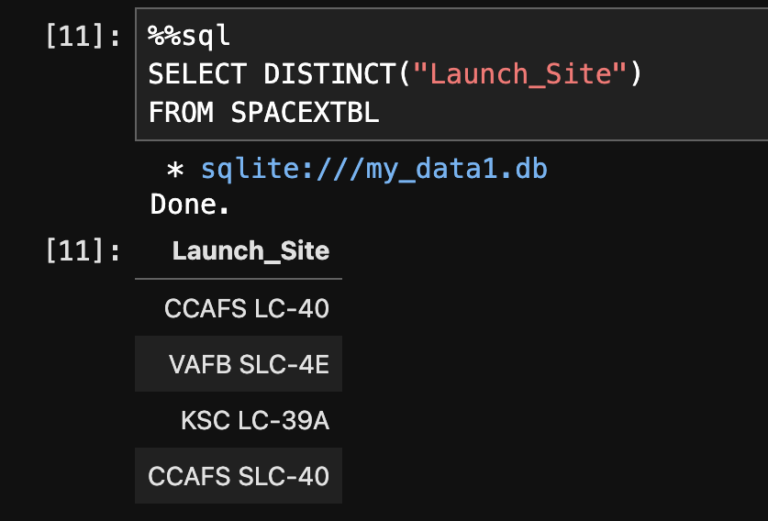
All Launch Site Names
We can see there are four unique launch sites in the entire dataset of Falcon 9 launches

Slide 25
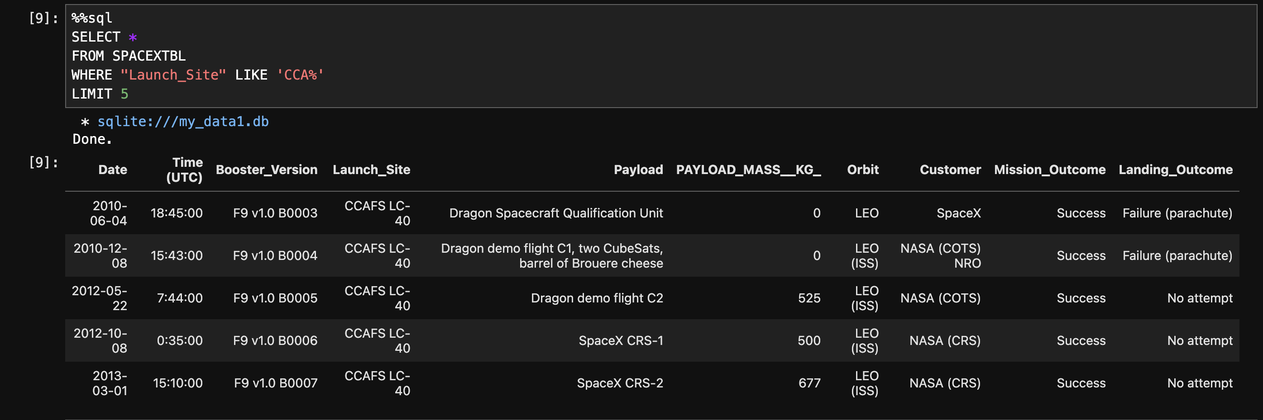
Launch Site Names Begin with ‘CCA’
First five Launches at Cape Canaveral

Slide 26
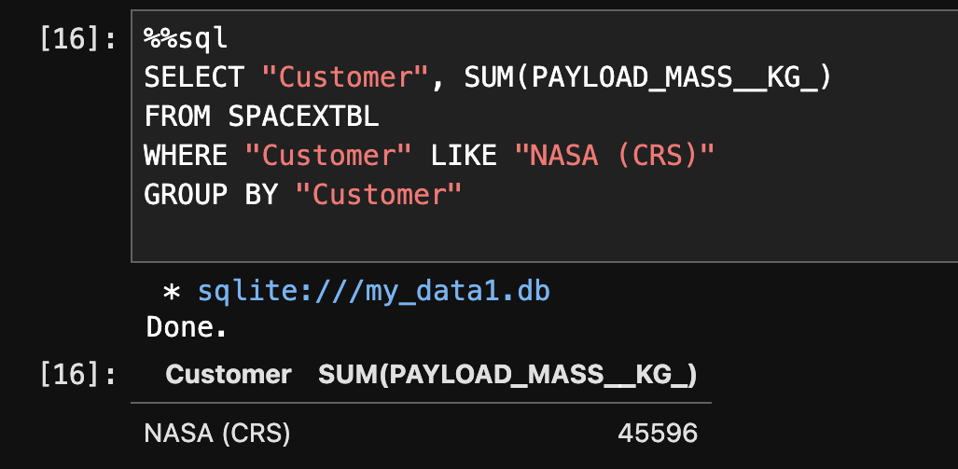
Total Payload Mass
Here we can see the total payload mass of every rocket launched with NASA as its customer

Slide 27
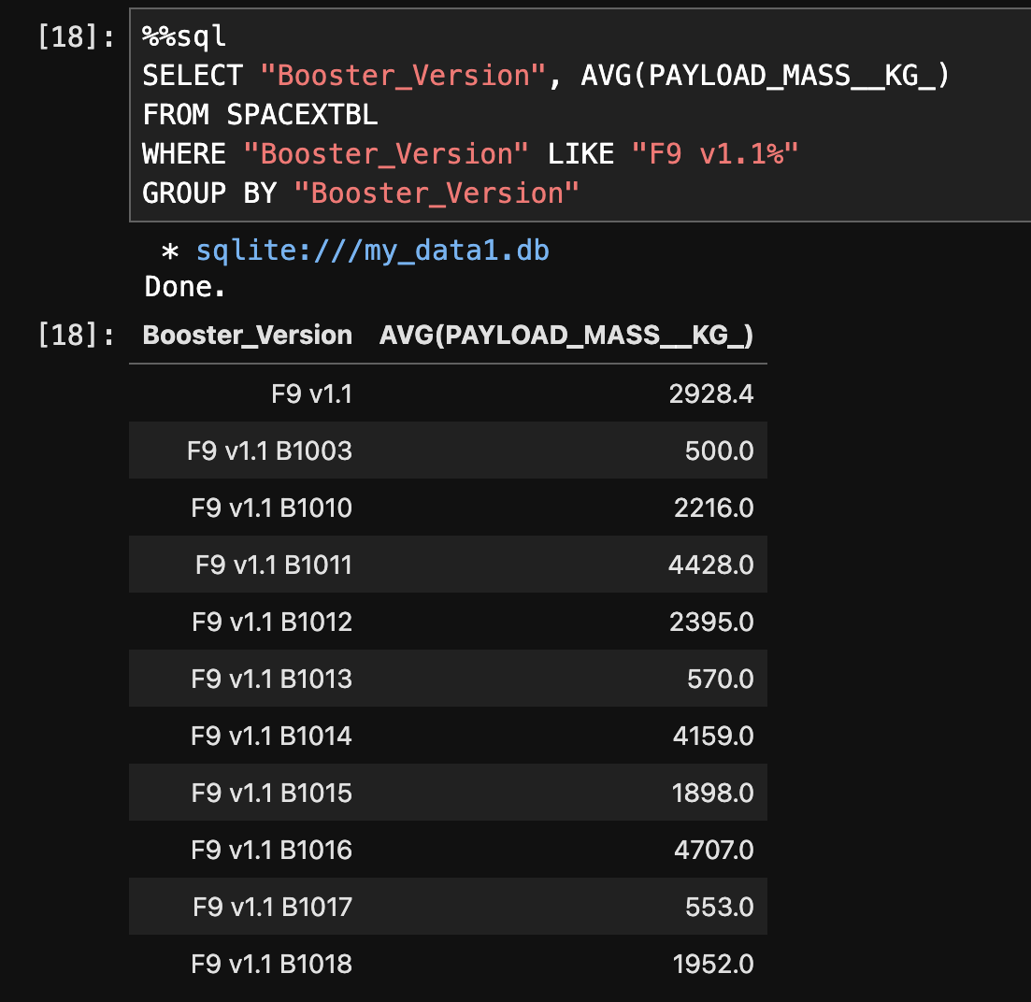
Average Payload Mass by F9 v1.1
The average payload mass by F9 v1.1 boosters ranges from 500 kg to 4707 kg

Slide 28
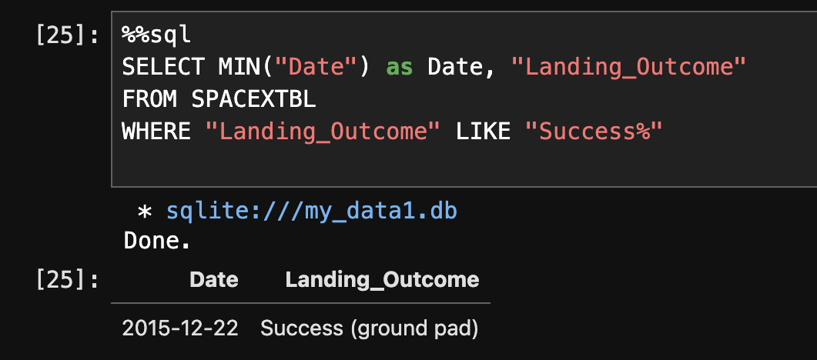
First Successful Ground Landing Date
Here we can see the first successful retrieval of the first stage happened in December of 2015

Slide 29
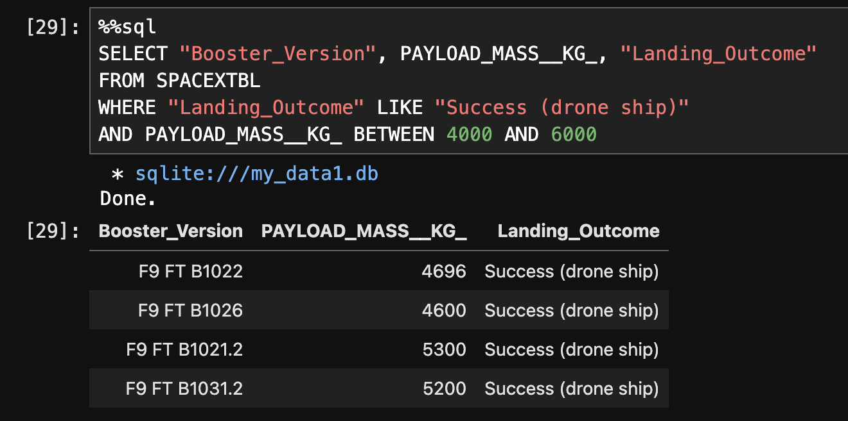
Successful Drone Ship Landing with Payload between 4000 and 6000
Within the dataset there are four instances of successful landings on a drone ship when payload is between 4000 kg and 6000 kg

Slide 30
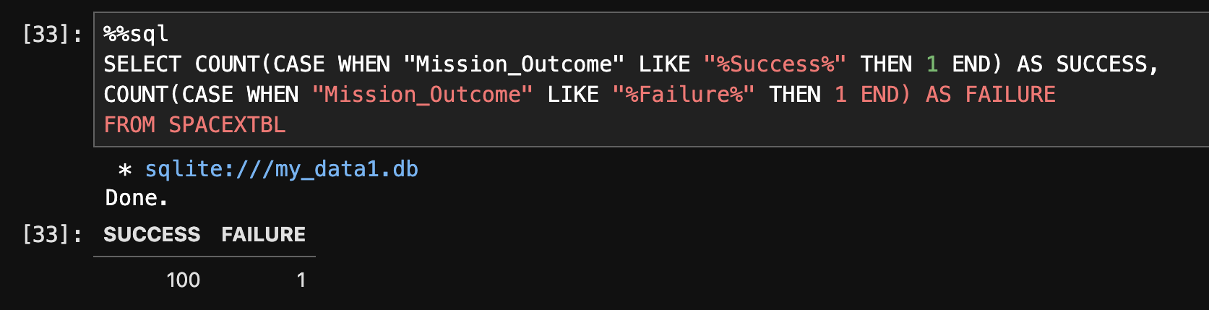
Total Number of Successful and Failure Mission Outcomes
Here we can see the ratio of successful missions to failed missions

Slide 31
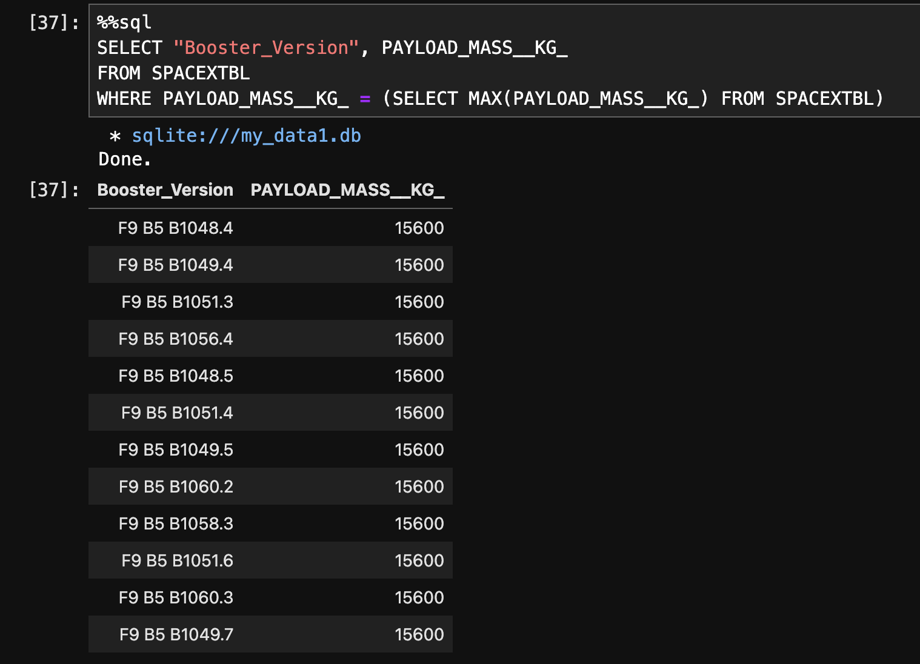
Boosters Carried Maximum Payload
We can see the max payload in kg to be 15600, with 12 boosters carrying that amount

Slide 32
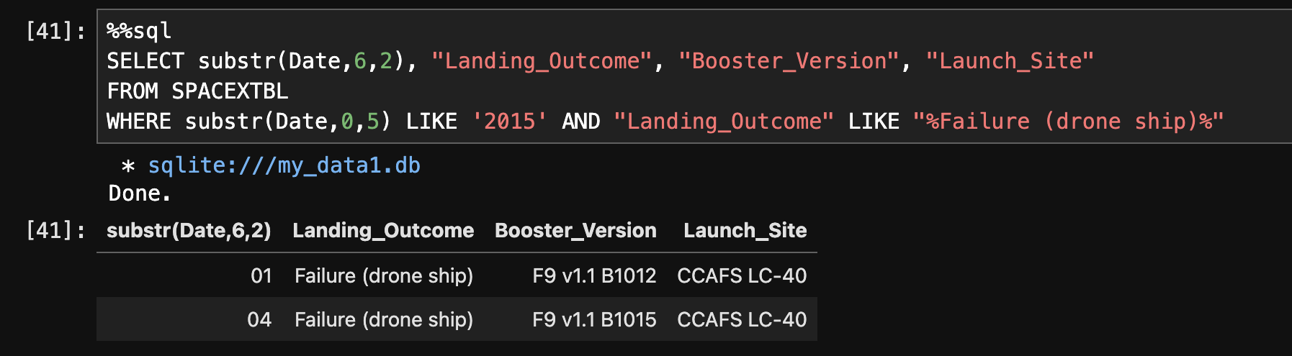
2015 Launch Records
Here we have one launch in January and one in April of 2015, both failed to land on a drone ship

Slide 33
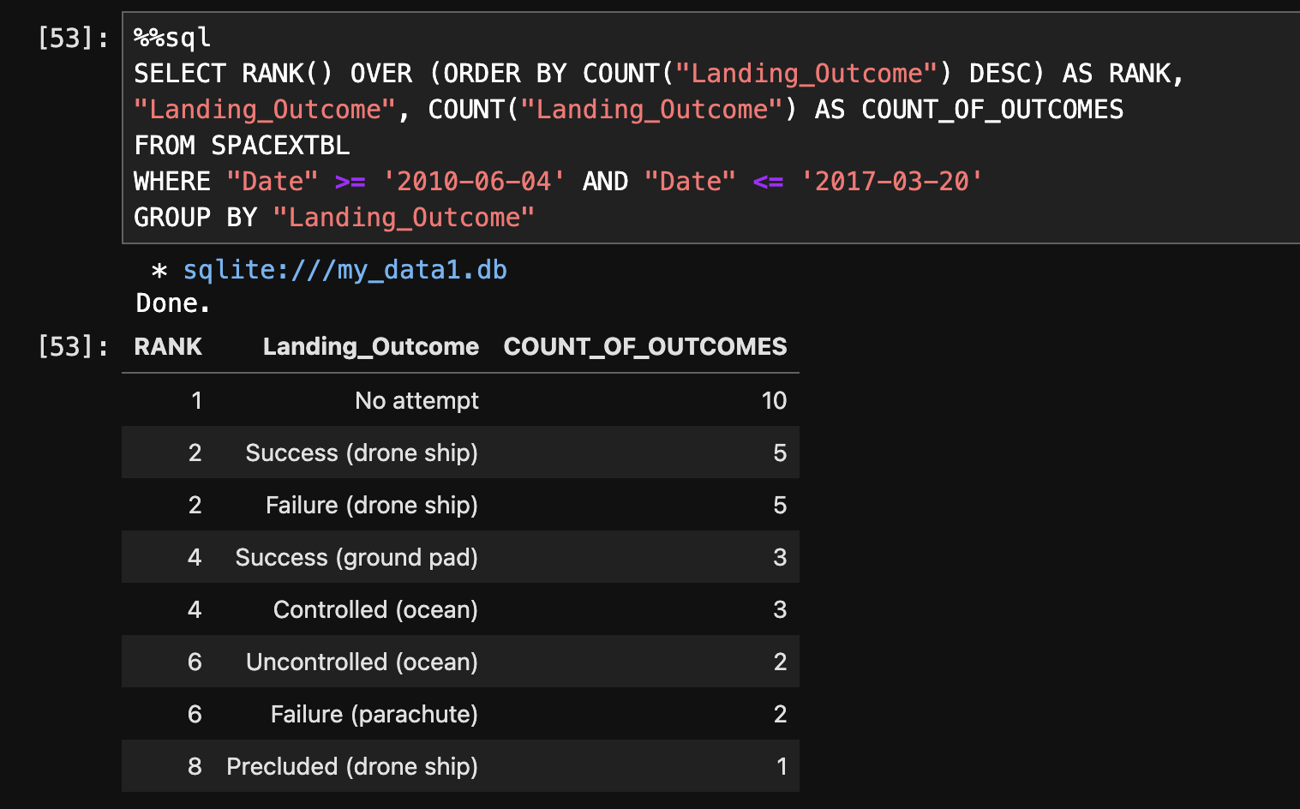
Rank Landing Outcomes Between 2010-06-04 and 2017-03-20
Here is the rank of landing outcomes by type
The most common outcome is no attempt
An equal amount of successful and failed drone ship landings

Slide 34
Launch Sites Proximities Analysis

Slide 35
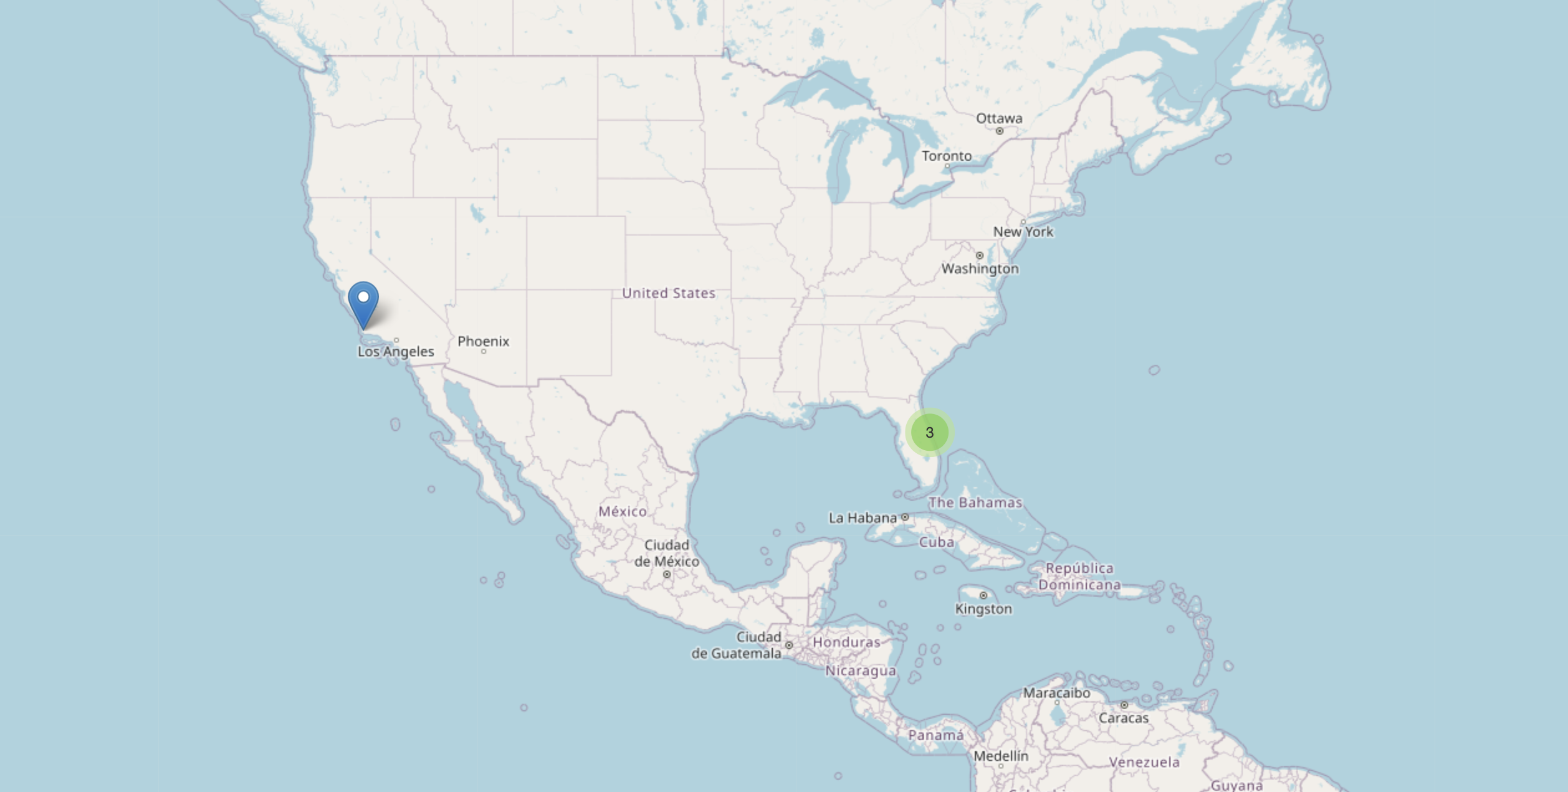
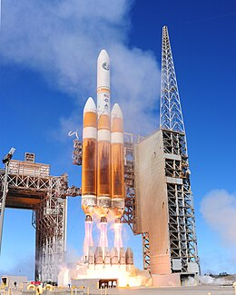
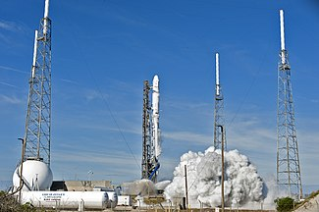
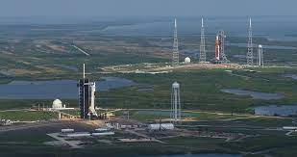
Launch Site Locations
California landing zones
Vandenberg Space Launch Complex 4 (VAFB SLC-4E)
Leased from US Space Force – First Falcon 9 launch in 2013
Florida landing zones
Kennedy Space Center Launch Complex 39A (KSC LC-39A)
Leased from NASA in April 2014 - First Falcon launch in 2017
Cape Canaveral Space Launch Complex 40 (CCAFS SLC-40) and previously Launch Complex 40 (CCAFS LC-40)
Leased from US Air Force in April 2007 – Frist Falcon 9 launch in 2010

Slide 36
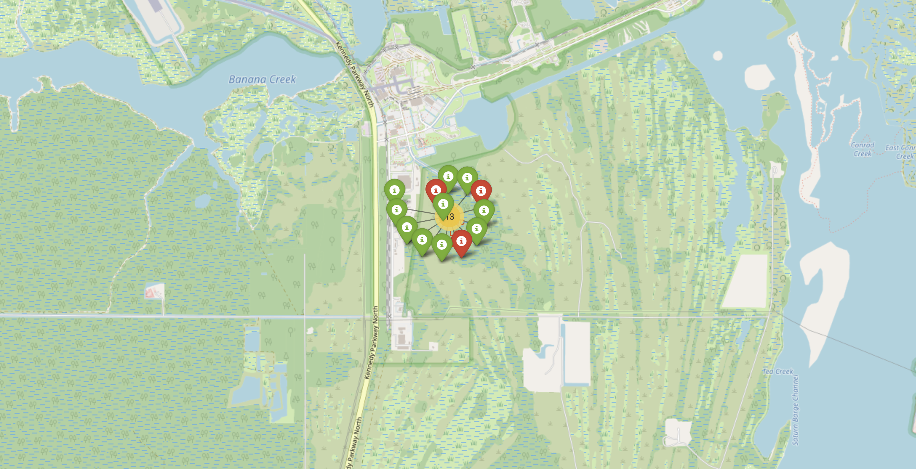
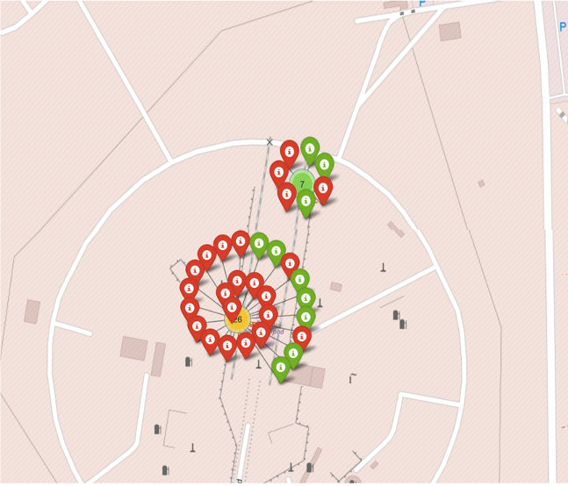
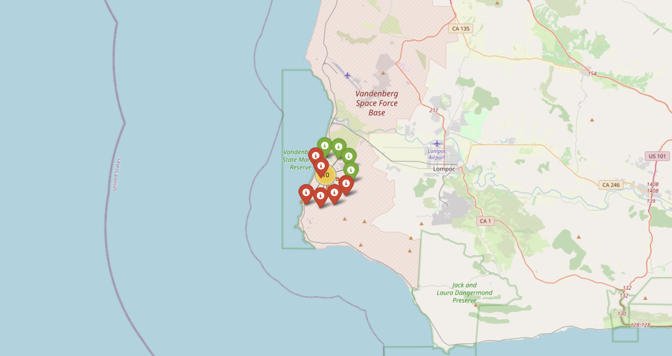
Launch Outcomes at each site
Kennedy Success Rate: 77%
Vandenberg Success Rate: 40%
Cape Canaveral Success Rate:
LC-40 (Bottom): 27%
SLC-40 (Above): 43%

Slide 37
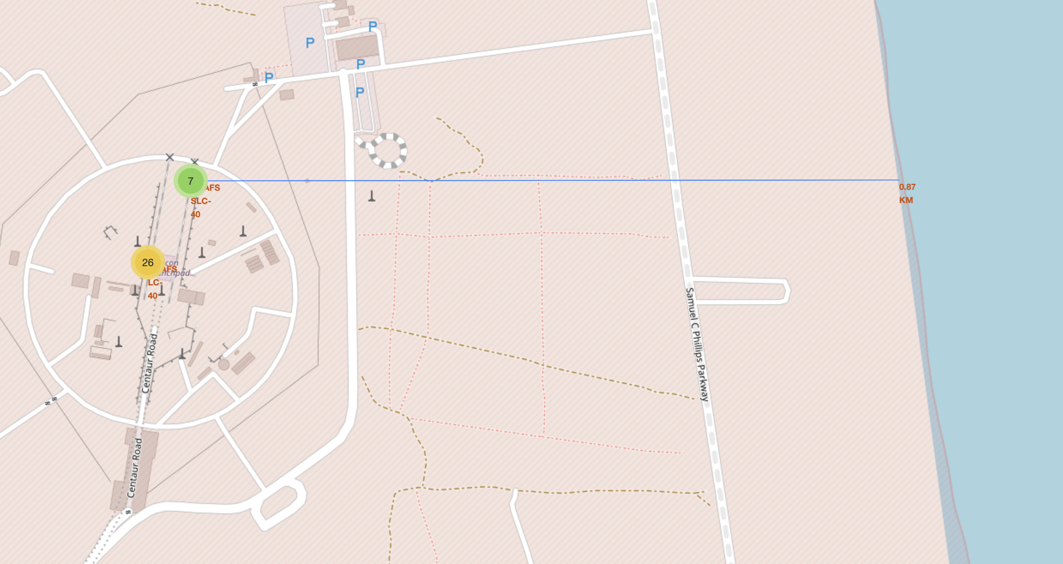
Closest Coast to cape Canaveral
The coastline is only .87 KM away from the Space Launch Complex at Cape Canaveral
The Launch Complex (LC-40) is a bit further but still relatively close to a coast

Slide 38
Build a Dashboard with Plotly Dash

Slide 39
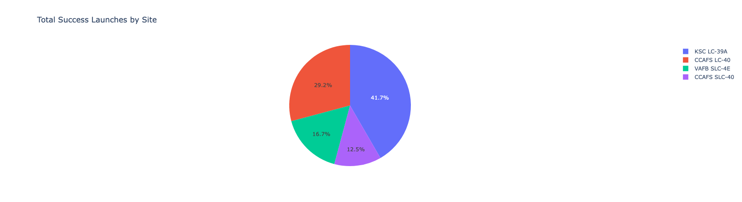
Launch Success for all sites
Kennedy Space Center has the highest number of successful launches compared to the other four
KSC is accounting for 41.7% of the total successful launches

Slide 40
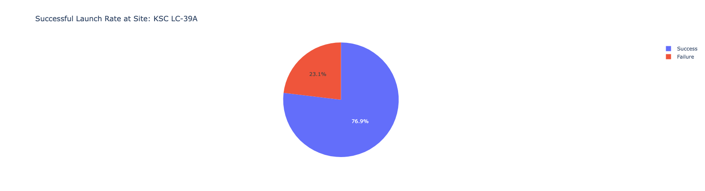
Kenney Space Center Success Rate
At Kennedy Space Center, we can see that 76.9% of all launches result in a Successful mission outcome

Slide 41
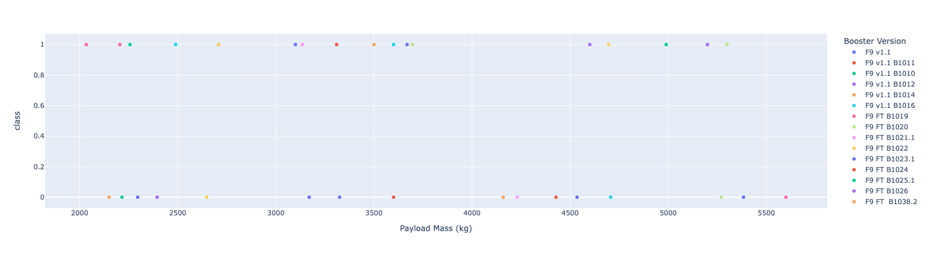
Payload vs Launch Outcome
Most launches fall in the 2000 to 5500 range of payload mass in kg

Slide 42
Predictive Analysis (Classification)

Slide 43
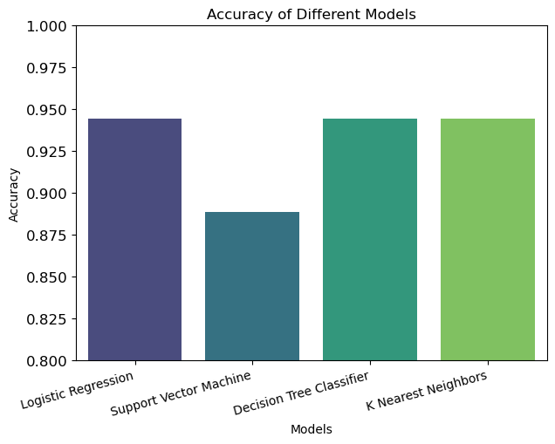
Classification Accuracy
Three of the four models have the best accuracy at about 94%
Support Vector Machine did not perform as well as the other three

Slide 44
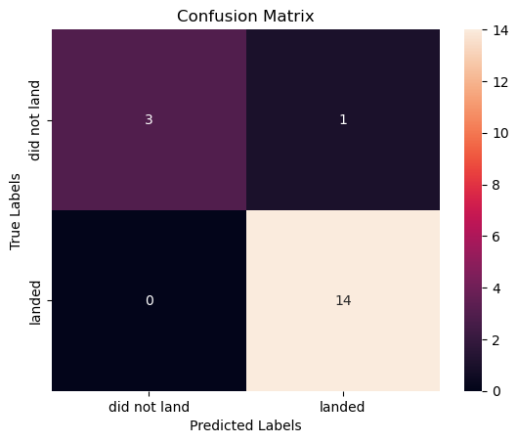
Confusion Matrix
Here is the confusion matrix for the logistic regression model
The model has perfect precision of negative outcomes and perfect recall of positive outcomes

Slide 45
Conclusions
We found three models that perform the best with an accuracy of ~94%
There is a strong increase in success rate over the course of the Falcon 9 project
Many of our selected features have a strong correlation to each other
Orbit types commonly have similar payload mass kg
We were more likely to have false positives than false negatives

Slide 46
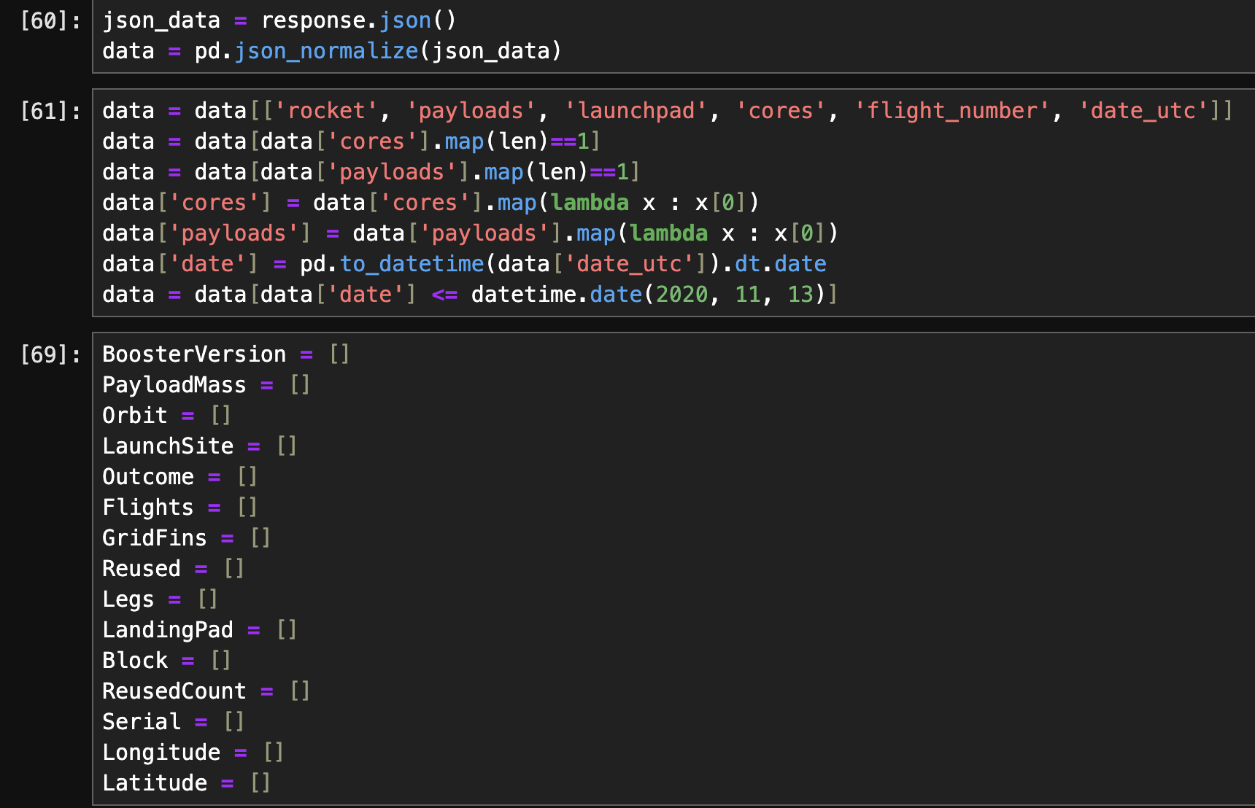
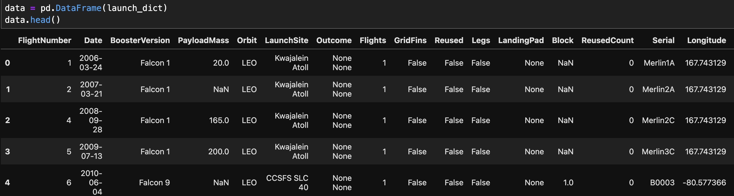
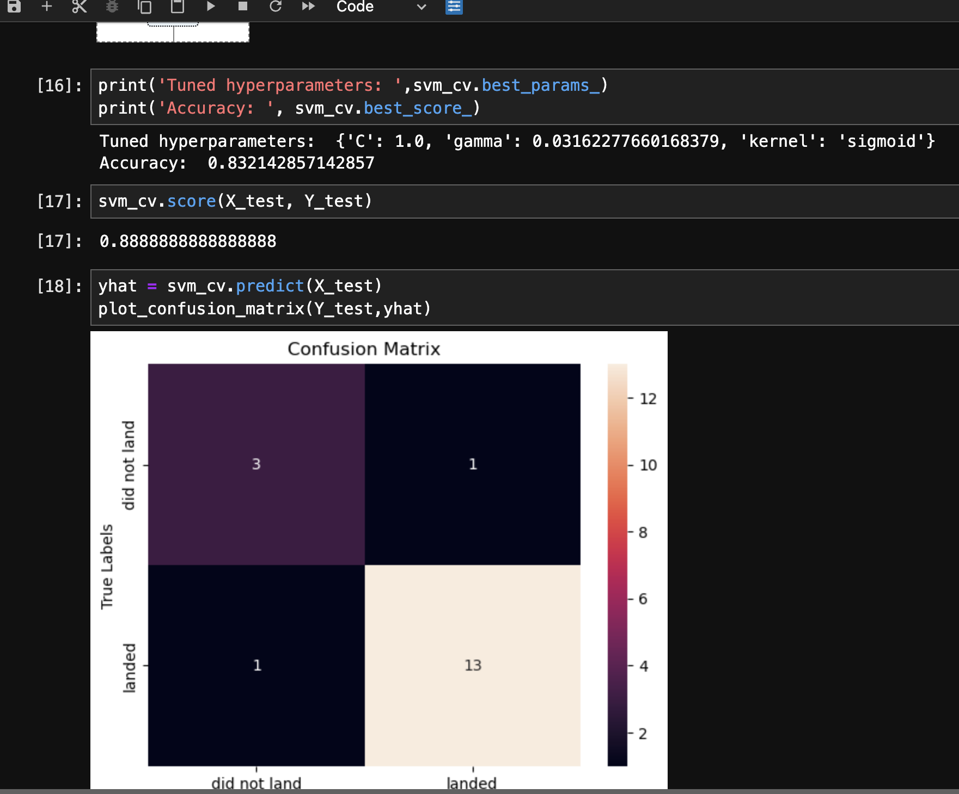
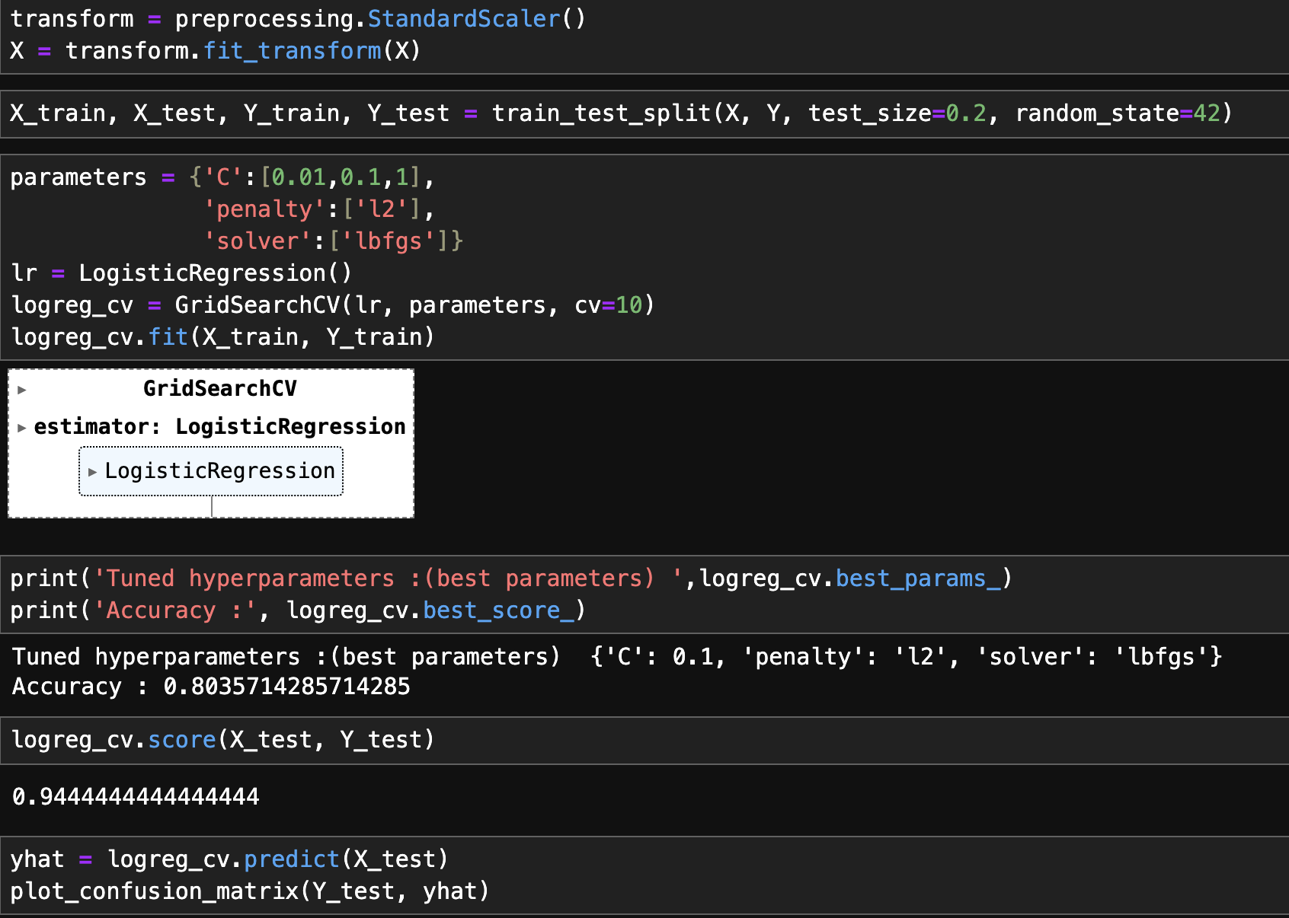
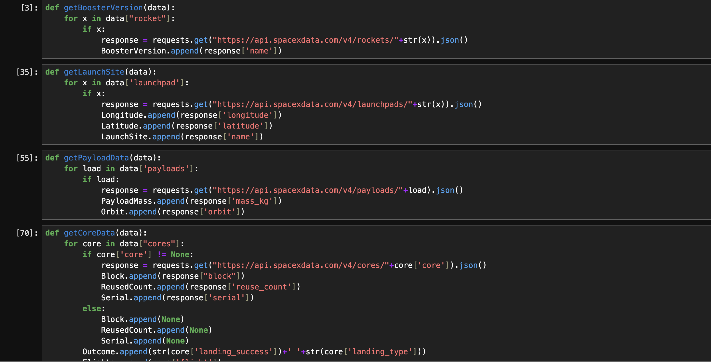
Appendix

Slide 47
Thank You!

